Slide 1
Chapter Eight
Improving Interpersonal Relations with Constructive Self-Disclosure

Slide 2
Chapter Preview: Improving Interpersonal Relations with Constructive Self-Disclosure
Why constructive self-disclosure improves interpersonal relationships and teamwork
Specific benefits gained from self-disclosure
Elements of the Johari Window model
Criteria for appropriate self-disclosure
Barriers to constructive self-disclosure
Applying knowledge and practicing constructive self-disclosure

Slide 3
Self-Disclosure: An Introduction
Lack of self-disclosure weakens the communication process
Self-disclosure can lead to more open and supportive environments

Slide 4
Self-Disclosure Defined
The process of letting another person know what you think, feel, or want
Revealing private, personal information that can not be acquire somewhere else
Usually involves some degree of risk

Slide 5
Self-Description Defined
Self-description involves disclosure of nonthreatening information
age
favorite food
where you went to school
Information that can usually be acquired in some other way
Differs from self-disclosure

Slide 6
Self-Disclosure
Examples include your feelings about
being a member of a minority group
job security
policies and procedures

Slide 7
Total Person Insight
It’s great when employees can read the subtle nuances of your behavior and figure out exactly what you require of them. But let’s face it: Most people aren’t mind readers. Even if they’re smart, they may be oblivious to what’s important to you—unless you spell it out for them.
Albert J. Bernstein and Sydney Craft Rozen
Authors, Sacred Bull: The Inner Obstacles that Hold You Back
at Work and How to Overcome Them

Slide 8
Four Benefits of Self-Disclosure
Increased accuracy in communication
Reduction of stress
Increased self-awareness
Stronger relationships

Slide 9
Increased Accuracy in Communication
People can not read minds
Take the guess work out of the process
Reporting both facts and feelings improves accuracy

Slide 10
Reduction of Stress
Emphasis on privacy and concealment of feelings creates stress
Sharing inner thoughts and feelings usually reduces stress
Stress symptoms can include
high blood pressure – perspiration
decline in immunization – rapid breathing

Slide 11
Increased Self-awareness
Self-awareness
The ability to recognize and understand your moods, emotions, drives and their effect on others
The foundation on which self-development is built
Increases as you receive feedback from others

Slide 12
Stronger Relationships
When two people engage in an open dialogue, they often develop a high regard for each other’s views
Enhances awareness of common interests and concerns

Slide 13
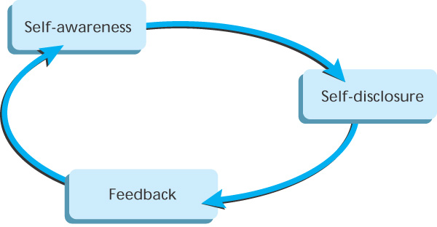
Figure 8.1
Figure 8.1
Self Disclosure/
Feedback/
Self-Awareness Cycle

Slide 14
The Johari Window: A Model for Self-Understanding
Model considers that there is information
you and others know
only you know about yourself
only others know about you
nobody knows

Slide 15
The Johari Window
Your willingness or unwillingness to engage is self-disclosure, and listen to feedback, has a lot to do with your understanding of yourself and others’ understanding of you.

Slide 16
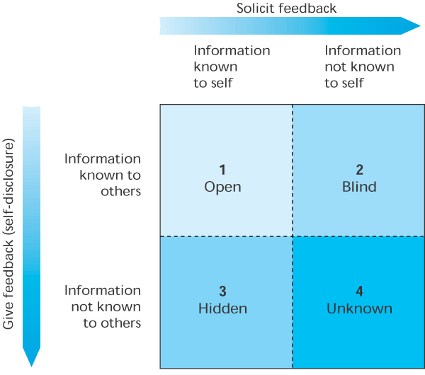
Figure 8.2
Johari Window
Figure 8.2
Source: Joseph Luft, Group Processes: An Introduction to Group Dynamics. Copyright © 1984. Mayfield Publishing Company. Reprinted by permission of the publisher.

Slide 17
The Four Panes of the Johari Window
Open
Blind
Hidden
Unknown

Slide 18
Open Area
Represents the “public” or “awareness” area and contains information that both you and others know
Information that you don’t mind admitting
Gets bigger over time as relationships mature

Slide 19
Open Area
A productive relationship is related to the amount of mutually held information
Building a relationship involved expanding this area

Slide 20
Blind Area
Information about yourself that others know but you are not yet aware
Others may see you differently than you see yourself
Effective relations strive to reduce this area
Open communication encourages people to give you feedback

Slide 21
Hidden Area
Information that you know that others do not
Private feelings, needs, and past experiences that you prefer to keep to yourself
If this area is too large, you can be perceived as lacking authenticity

Slide 22
Unknown Area
Information that is unknown to you and to others
Areas of unrecognized talent, motives, or early childhood memories that influence your behavior
Always present, never disappears
Open communication can expose some of this area

Slide 23
Johari Window
The four panes are interrelated
Changes to one pane impact the size of the others
As relationships develop, the open area should grow

Slide 24
Self-Disclosure/ Feedback Styles
Two communication processes within our control that impact relationships:
Self-disclosure of thoughts, ideas, and feelings
Seeking feedback from others
Characteristics of using both effectively:
candor
openness
mutual respect

Slide 25
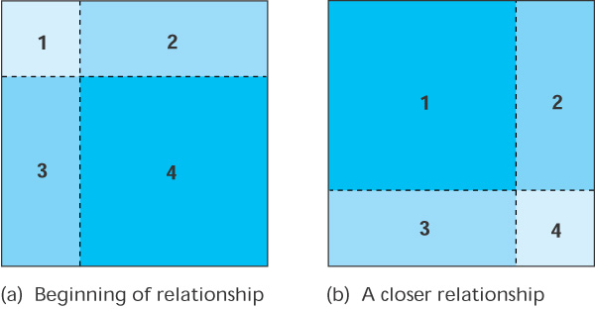
Figure 8.3
Johari Window at the Beginning of a Relationship (left)
and After a Closer Relationship Has Developed (right)
Figure 8.3
Source: Joseph Luft, Group Processes: An Introduction to Group Dynamics © 1984. Mayfield Publishing Company. Reprinted by permission of the publisher.

Slide 26
360-Degree Feedback
360-degree feedback is based on belief that employees will benefit from feedback collected from several sources
Evaluations by boss, peers, subordinates, and sometimes customers
Often in questionnaire form
Involves risk if not done correctly

Slide 27
Appropriate Self-Disclosure
Information should be disclosed in constructive ways
Anyone can learn this skill
Often means changing attitudes and behaviors
Questions about disclosing information:
How much and how intimate?
With whom?
Under what conditions?

Slide 28
Repair Damaged Relationships
Many work relationships are unnecessarily strained
People refuse to talk about real or imagined problems
Self-disclosure can be an excellent way to repair damaged relationships

Slide 29
The Art of Apologizing
A sincere apology has healing power
Can improve communication in the future
Apologize if actions caused hurt feelings, anger, or deep-seated ill will

Slide 30
The Art of Apologizing
Apologize in private so that feelings can be exchanged in relative comfort
Apologize completely—should include:
Regret
Responsibility
Remedy
Avoid the “I am sorry for what happened, but you shouldn’t have….”

Slide 31
Total Person Insight
Almost like magic, apology has the power to repair harm, mend relationships, soothe wounds and heal broken hearts.
Beverly Engel
Author, The Power of Apology

Slide 32
The Art of Forgiveness
Be quick to forgive!
It is never easy, but is the only way to avoid blame and bitterness
To forgive means to give up resentment and anger
Forgiveness heals, and liberates energy and creativity

Slide 33
Constructive Criticism
Constructive criticism is a form of self-disclosure that helps another person look at their own behavior without putting that person on the defensive
Not the same as blaming

Slide 34
Constructive Criticism
Skill that can be mastered through learning and practice
Replace “You” statements with “I” statements
Request changes “in the future” instead of pointing out something negative in the present

Slide 35
Disturbing Situations
Share reactions to work-related problems as soon as possible after the incident
Not easy to recapture the feelings
Distortions of the incident if too much time passes
Holding things in impacts:
Mental and physical health
Job performance

Slide 36
Describe Accurately
Sharing feelings involves risk
You are trusting the other person not to ridicule or embarrass you
Emotions in the work setting sometimes viewed as inappropriate
Yet, emotions are an integral part of human behavior

Slide 37
Describe Accurately
When reporting feelings, be sure the other person knows that your feelings are temporary and capable of change

Slide 38
The Right Time and Place
What you say may be fine, the when and where may be the problem
Select a time when the other person will not be preoccupied and will give full attention
Select a place free from distractions such as telephone calls or visitors
Make an appointment, if necessary

Slide 39
Avoid Overwhelming Others
Be open, but do not go too far too fast
Relationships are built slowly
Abrupt disclosure of emotional or intimate information may distance you from others
Balance between openness and protection of each other’s feelings

Slide 40
Avoid Overwhelming Others
Buddha recommends asking yourself three questions before speaking:
Is the statement true?
Is the statement necessary?
Is the statement kind?
If the statement falls short on any one, Buddha advised that we say nothing

Slide 41
Barriers to Self-Disclosure
Why do people conceal their thoughts and feelings?
Why are candor and openness so uncommon in organizations?
Several barriers prevent self-disclosure

Slide 42
Lack of Trust
Trust exists when you fully believe in the integrity and character of the other person or organization
Complex emotion that combines three components:
Caring
Competency
Commitment

Slide 43
Lack of Trust
The most common and the most serious barrier to self-disclosure
Communication suffers as the level of trust declines
People are less likely to discuss problems and issues

Slide 44
Lack of Trust
Trust in organizations is declining:
Rapid changes
Uncertainty caused by frequent layoffs
Business scandals
Lack of trust can cause:
Culture of insecurity
High turnover
Poor customer relations
Marginal loyalty

Slide 45
Lack of Trust
Level of trust is a thermometer of individual and group health
Build trust by being trustworthy all the time!

Slide 46
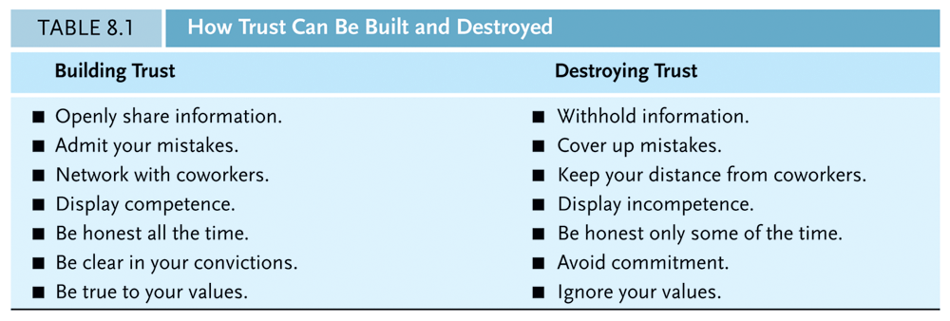

Slide 47
Total Person Insight
Trust is the core of all meaningful relationships. Without trust there can be no giving, no bonding, no risk taking.
Terry Mizrahi
President, National Association of Social Workers

Slide 48
The Fear/Distrust Cycle
The cycle begins with Theory X management philosophy
People are basically lacking in motivation and cannot be trusted
Management tries to maintain tight control over employees with strict rules and regulations
Management believes this will result in maximum production

Slide 49
The Fear/Distrust Cycle
Workers often become more defensive and resentful.
The spirit of teamwork diminishes
“We” versus “They” talk increases

Slide 50
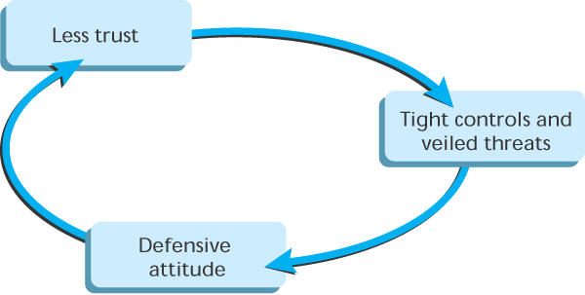
Figure 8.4
Figure 8.4
Fear/Distrust Cycle

Slide 51
Role Relationships Versus Interpersonal Relationships
Self-disclosure is more likely to take place within an organization when people
Feel comfortable stepping outside their assigned roles
Display more openness and tolerance for the feelings of others

Slide 52
Role Relationships Versus Interpersonal Relationships
Role expectations are often clearly specified
Some have trouble stepping outside an impersonal role at work
Supervisors often seem role as impersonal

Slide 53
Role Relationships Versus Interpersonal Relationships
Some may draw a sharp line of distinction between
role relationships
interpersonal relationships
Distinctions usually inspire lack of trust

Slide 54
Practice Self-Disclosure
Do you need to practice more self-disclosure?
Could you benefit by telling others more about your thoughts, feelings, wants and beliefs?

Slide 55
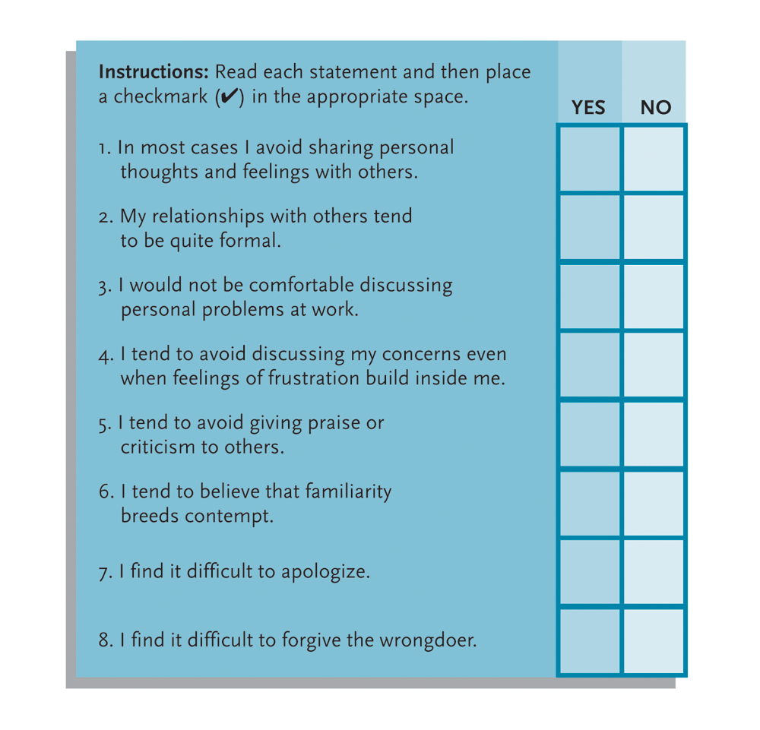
Figure 8.5
Self-Disclosure Indicator

Slide 56
Practice Self-Disclosure
Becoming a more open person is not difficult if you practice
Take small steps
Begin with telling someone how you honestly feel
Move toward more challenging encounter

Slide 57
Practice Self-Disclosure
With practice you will
Feel more comfortable
Find self-disclosure rewarding
Find others begin to open up and share more thoughts, ideas, and feelings with you
Everyone Wins!

Slide 58
Summary
Open communication is the key to job satisfaction and personal growth
Self-disclosure promotes communication within an organization
Most people want and need accurate feedback from coworkers and supervisors

Slide 59
Summary
Constructive self-disclosure can pave the way for
Increased accuracy in communication
Reduction of stress
Increased self-awareness
Stronger interpersonal relationships

Slide 60
Summary
The Johari Window helps conceptualize four kinds of information areas involved in communication
Open: you and others know
Blind: only others know
Hidden: only you know
Unknowns: no one knows
Open area grows as relationships develop

Slide 61
Summary
Everyone can learn to use self-disclosure in a constructive way
Describe feelings and emotions accurately
Avoid making judgments
Repair damaged relationships
Learn art of apologizing and forgiveness
Discuss as situations happen
Select the right time and place
Avoid inappropriate disclosure

Slide 62
Summary
Trust serves as the foundation for self-disclosure
Sensitivity to others and stepping out of assigned roles builds trust
Everyone can improve their ability to disclose thoughts and feelings

